Slide 1
DIGITAL SWITCH OVER (DSO)
A Presentation by
Engr. Sadeeq Omeiza Musa
Ag. General Manager(ITS)
INTEGRATED TELEVISION SERVICES LIMITED(its)

Slide 2
Discussing
Why Digital Switch over?
What role does Presidential Advisory
committee (PAC) Played?
Who is Digiteam?
Creation of ITS

Slide 3
WHY DIGITAL SWITCH OVER ?
Broadcasting is a vital part of Nigeria’s Communication and information Infrastructure.
Nigeria is a signatory to Geneva2006 (GE2006) with ITU which had earlier set June 2015 as the deadline for transition from analogue to digital broadcasting.

Slide 4
International Telecommunication Union(ITU) is the oldest agency of United Nations.
ITU, coordinates and regulates the use of Radio Frequency spectrum worldwide .

Slide 5
THE PRESIDENTIAL ADVISORY COMMITTEE (PAC)
In furtherance to the ITU’s transition deadline
for Nigeria, the Federal Government
set up a Presidential Advisory Council (PAC)
on the transition from Analogue to Digital
broadcasting in the year 2007.
On 11th July 2011, the White Paper Drafting was committee was constituted.
The result of the white Paper led to the creation of Digiteam Nigeria.

Slide 6
THE ROLE OF DigiTEAM NIGERIA
DigiTeam Nigeria was inaugurated on 22nd December 2012.
DigiTeam’s assignment was to bring to fruition the transition from Analogue to Digital
Broadcasting in Nigeria. In line with it’s mandate of ensuring appropriate coordination
with other African Countries at the ECOWAS sub region and Africa union at continental
levels.
DigiTeam worked with the Broadcast Regulators of all ECOWAS Countries to develop a Common Transmission standards and a minimum Specification for Set Top
Boxes and Digital Television Receivers.
Th

Slide 7
THE ROLE OF DigiTEAM NIGERIA
DigiTeam in collaboration with NBC worked out the modalities for splitting broadcast services into Broadcast Content Provider and Broadcast Signal Distributors.
DigiTeam worked out the modalities,
implementation processes for the establishment and the conditions of operation of Broadcast Signal Distributors

Slide 8
DSO VALUE CHAIN
In response to the challenges of the Digital migration, the licensing legal framework in the Broadcasting Industry was structured along namely,
(a) Television Service License- the authority to produce a content, and
(b) Broadcast Distribution License –the authority to provide transmission platform to broadcasters

Slide 9
DSO VALUE CHAIN
(c) And Local Set Top Box manufacturers-the authority to manufacture the Set Top Boxes.
CONTENT
PROVIDER
STB
MANUFACTURERS
VIEWERS
SIGNAL DISTRIBUTORS

Slide 10
DSO Value Chain
*Broadcasters (Content Provider) ( NTA & others)
* Aggregator/Mux Provider ( SES )= CCNL = FTPN
*Broadcast signal Distributors ( ITS & Pinnacle)
* Set Up Box Manufacturers ( TVE, Gospel etc)

Slide 11
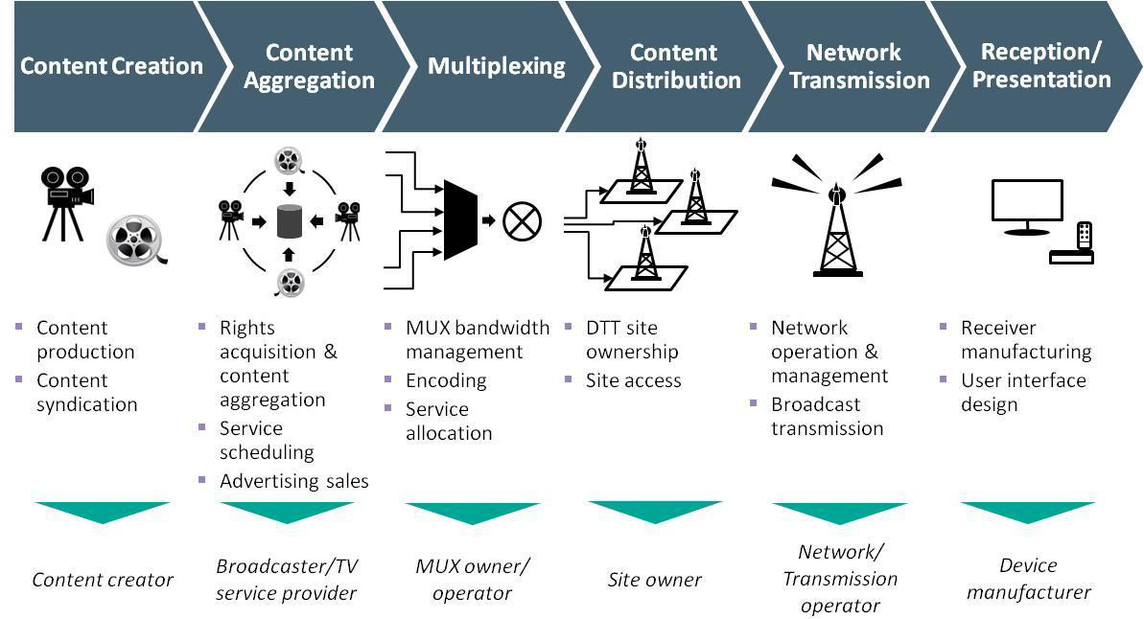
DSO VALUE CHAIN

Slide 12
BROADCAST SIGNAL DISTRIBUTION INTEGRATED TELEVISION SERVICES(ITS
ITS is a company licensed as a Broadcast Signal Distributor by the National Broadcasting Commission, NBC. It was carved out of NTA in line with Government white Paper on Digital transition in Nigeria.
ITS was registered as a company with Corporate Affairs Commission (CAC) in September ,2015.
ITS is to inherit all NTA transmission facilities the Masts, Transmitters, Transmission paths/halls, Antenna systems and land on which they are erected according to the white paper.

Slide 13
ITS VISION AND MISSION
VISION
The world enabler of broadcasting and digital content delivery.
MISSION
To enable our broadcasters/content providers to reach their audiences anywhere through innovation.
VALUES
Integrity, Quality Customer Service, Innovation, Accountability & Social Responsibility
“

Slide 14
INTEGRATED TELEVISION SERVICES(ITS)
ITS has capacity to transmit for now 2 Multiplexes
and in future 4 Multiplexes using the standard DVBT2 in a 2+1 Transmitter configuration.
Signal Processing equipment that supports Single Frequency Network(SFN)
Video compression Format is MPEG 4 , H264.
Tx standard is DVB-T2
Transmission Sites has provision for Playout Systems, Signal Evacuation Capabilities, PVOD(Push video on Demand),audience measurement, information and EPG services.

Slide 15
INTEGRATED TELEVISION SERVICES(ITS) ADDED VALUE
As a national broadcast signal distributor , we understand that the choice of technology is critical to the industry success in a digital era. As a result, ITS offers client consultancy services for the procurement and Installation of studio and links equipment to the state government, Higher Institutions and other stakeholders.

Slide 16
Value chain [multi-platform]
CONTENT PROVIDER / AGGREGATOR
CONTENT DISTRIBUTION
Broadcasting
DTT / DTH
Production
Broadcasting
VIEWERS
Production
IPTV / Internet
Broadcasting
Mobile
LTE / 5G
Production

Slide 17
ITS HEADEND AND TRANSMITTER STATION

Slide 18
ITS DTT SCHEMATIC

Slide 19
INTEGRATED TELEVISION SERVICES(ITS)
ITS is currently operational in 4 states, namely , Jos, Enugu , Ilorin and Osogbo with a coverage level of between 45-50% in each of these states
A Second Licensed Broadcast Signal Distributor, Pinnacle Communications Ltd radiates in Abuja and Kaduna.
INTEGRATED TELEVISION SERVICES LIMITED(its)

Slide 20
BENEFITS OF DSO
Digital Terrestrial Transmission has a number of benefits including but not limited to improved and good quality audio visual reception, use of new multimedia applications such as IPTV and OTT with improved spectrum efficiency and increase in Television channels
Spectrum so released to Telecos will be a huge source of revenue to the government.
Viewers has options of watching variety of channels
More Job is created for content providers to fill the multiple available channels.
The local Set Top Boxes manufacturer creates Job for the qualified unemployed youths.
NBC license more content providers and signal distributors thereby generating more revenue.

Slide 21
CHALLENGES IN THE ECOSYSTEM
Government policy
Funding
Politics/Personal Interest

Slide 22
THE END
THANKS FOR YOUR ATTENTION
INTEGRATED TELEVISION SERVICES LIMITED(its)

