Slide 1
Brief on The Migration from Intelsat to Nigcomsat
Delivered by
Engr. Bakare Sikiru

Slide 2
Introduction
Nigerian Communication Satellite Limited (Nigcomsat) is a company and agency under the Federal Ministry of Communication.
Nigcomsat-1R was launched in December 2011 as a replacement to Nigcomsat-1
It is a Hybrid satellite providing the following services

Slide 3
Nigcomsat Abuja

Slide 4
Why Nigcomsat?
Lowest Cost Solution that meet Clients requirements in Naira
Indigenous and 100% Proudly Nigerian.
Expert with years of Experience in Solution Development and Post Implementation Support
We don’t only deploy Solution, we work together with our clients to evolve a robust solution
Supports Capacity Building and Knowledge Transfer(Training).

Slide 5
Nigcomsat in space

Slide 6
Services
Broadcast Services
Navigational Services
Broadband services
C-Band
Ku-Band
Ka-Band
L-Band
Extended C-Band

Slide 7
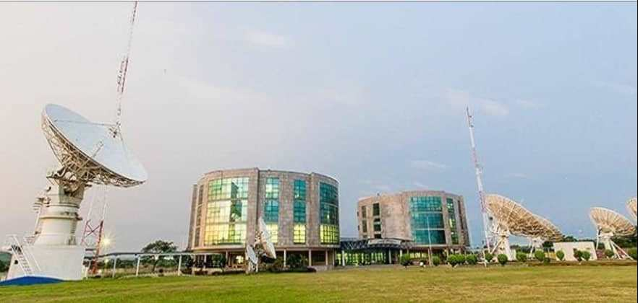
Nigcomsat Earth station

Slide 8
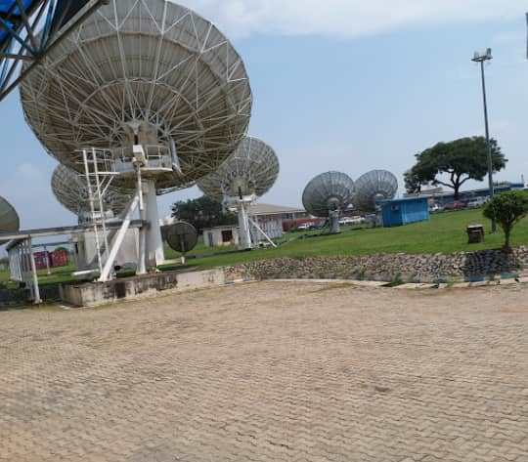
Nigcomsat Dish Farm

Slide 9
Features
Strong Footprint
.Better Look angle
Powerful Signal strenght
Increased reliabilty
Reduced cost of Deployment

Slide 10
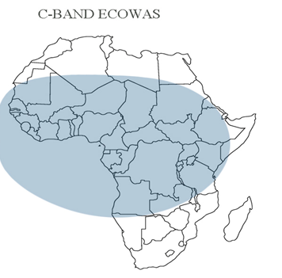
Footprints in Africa

Slide 11
Advantage over Intelsat
The cost of 1MHZ C-band on Nigcomsat-1R as compared with intelsat 903/907 is better
.Using Nigcomsat-1R reduce capital flight
The Effective Isotropic Radiation power(EIRP) of Nigcomsat-1R is better than that of Intelsat903/907
Reduce and Portable customer premise equipment size of an antenna and BUC is greatly impacted upon

Slide 12
Satellite Backup
Turksat
Belin telsat
Engineering Support
Tier1: call on phone to solve problemTier2: Unresolved problem on Phone and send support Engineer from Nigcomsat

Slide 13
Engineering Support
Tier3: The support Engineer cannot resolve the problem and the big boss has to come
10MHZ : for synchronisation
The BUC of the modulator must have facility to generate 10MHZ for Nigcomsat operations

Slide 14
Nigcomsat Frequency Plan for NTA
10MHZ Assigned Bandwidth 42.5 degree east(Nigcomsat1-R)
CARRIER | UPLINK/DOWNLINK | FREQUENCY
NTA CARRIER1 | UPLINK | 6511.27MHZ
LAGOS DSTV NTA2 | DOWNLINK | 3586`27MHZ
NTA CARRIER 2 | UPLINK | 6513.31MHZ
CONTRIBUTION SAT1 | DOWNLINK | 3588`31MHZ
NTA CARRIER 3 | UPLINK | 6515`35MHZ
CONTRIBUTION SAT 2 | DOWNLINK | 3590.35MHZ
NTA CARRIER 4 | UPLINK | 6517.39MHZ
ABUJA FREE TV & STARTIMES, NTA CH % | DOWNLINK | 3592.39MHZ
NTA CARRIER 5 | UPLINK | 6519.43MHZ
DISTRIBUTION NETWORK | DOWNLINK | 3594.43MHZ

Slide 15
Parameter Plan
Symbol Rate: 1.3mbs
FEC: ¾
Modulation Code 8PSK
Carrier Separation : 0.22MHZ

Slide 16
Advantages of BUC over HPA
Why do we move from HPA to BUC HPA has a high power?
Power Consuption :HPA comsumes about 400watts, but BUC comsumes Low Power
BUC is less bulky and occupies lesser space unlike HPA
Cost effectivness of BUC makes it have advantage over HPA

Slide 17
Intelsat

Slide 18
Intelsat 903/907(34.5degree west/27.5degree west)
It is a communication satellite operated by intelsat .
It was lunched on 30th march 2002(IS 903)
It was also lunched on 15th February 2003(IS 907)

Slide 19
Services
Broadcasting
Business services
Broadband services
Direct to home
TV Broadcasting
Telecommunication

Slide 20
Abbreviations
EIRP-Effective Isotropic Radiated Power
SFD- Saturated flux density

Slide 21
THANK YOU FOR YOUR ATTENTION!

