Slide 1
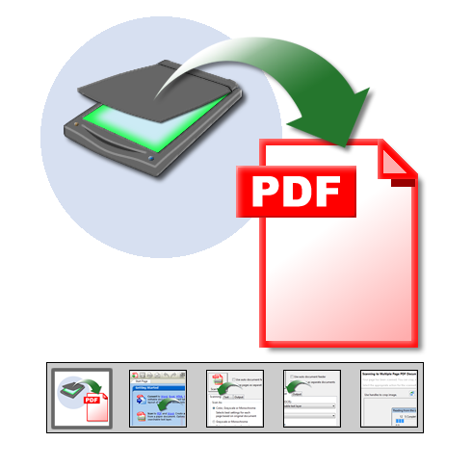
SCANNING
DOCUMENT
TO
PDF
By:-
Samuel A. Olalude, mcpn

Slide 2
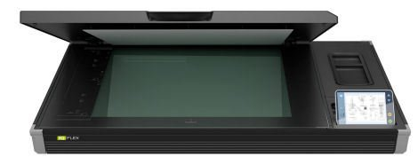
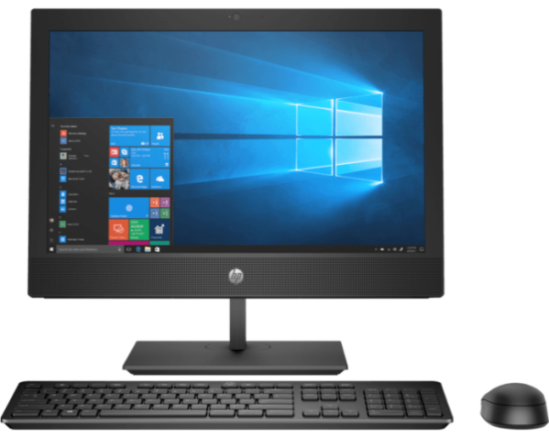
REQUIREMENTS
SCANNER
A Personal Computer (PC)
ANY PDF READER SOFTWARE

Slide 3
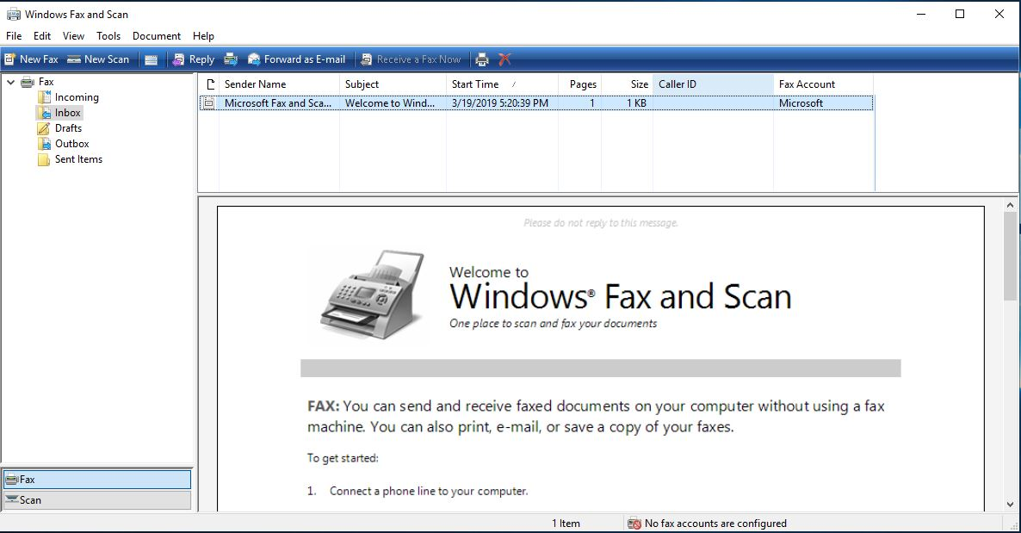
STEP 1
Scan Documents using existing scanning application on your PC.

Slide 4
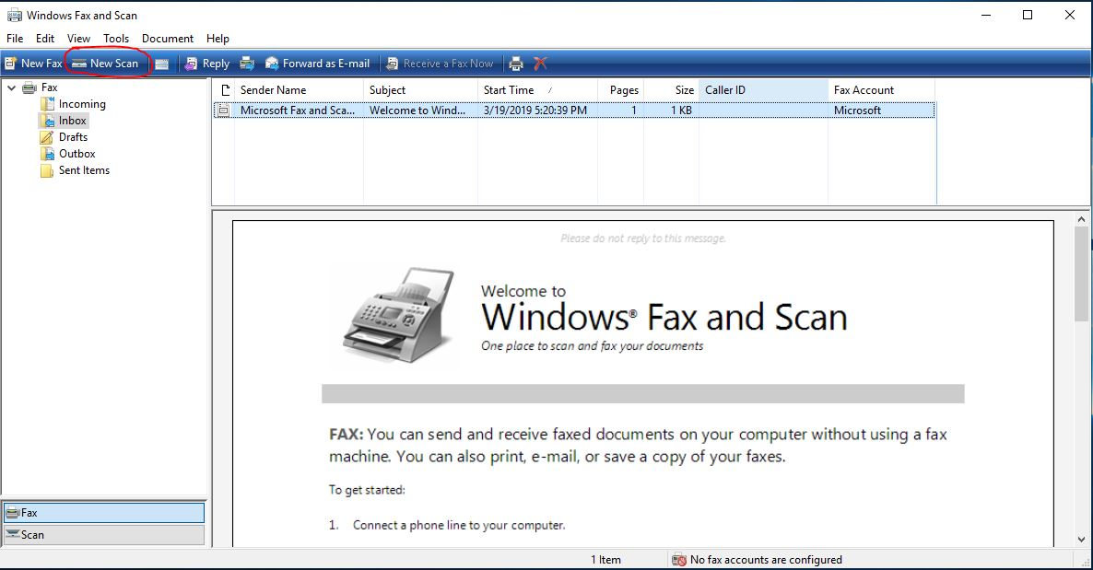
STEP 2
Place the Document properly on the scanner glass, Then click NEW SCAN

Slide 5
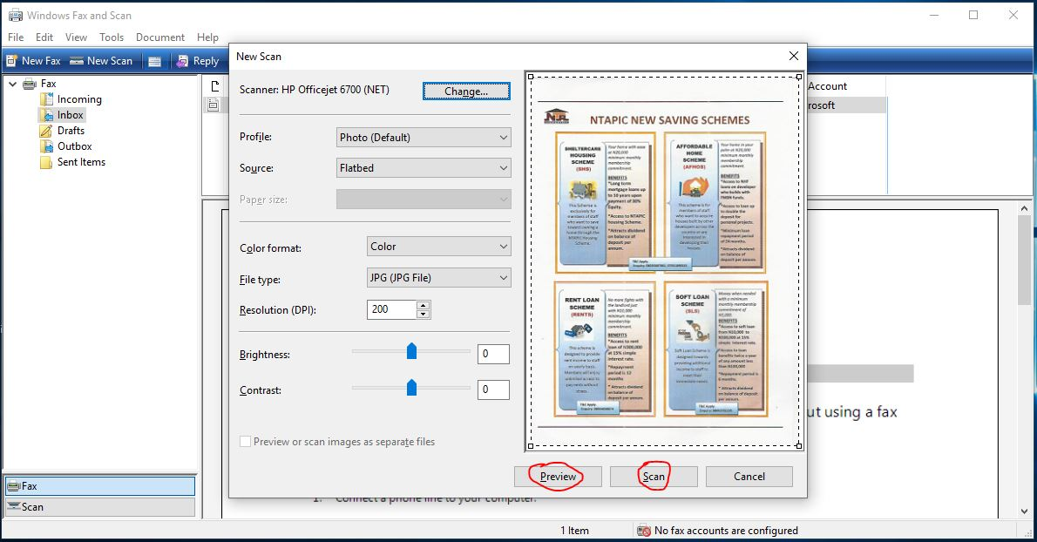
STEP 3
Click PREVIEW button to view the output.
Click SCAN button to get the soft copy on PC.

Slide 6
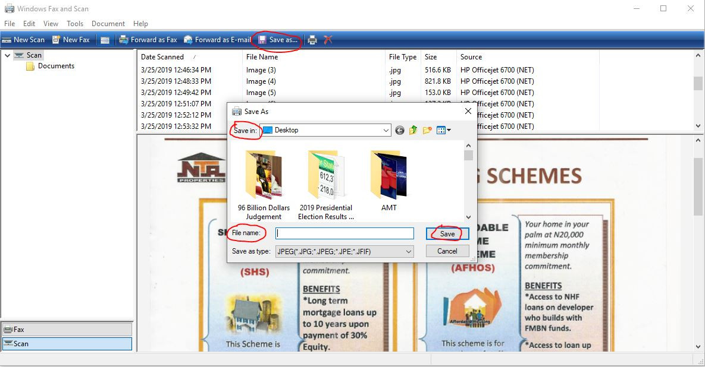
STEP 4
Save the Scanned Copy with a name to a known folder.
Repeat STEP 2 for more scan.

Slide 7
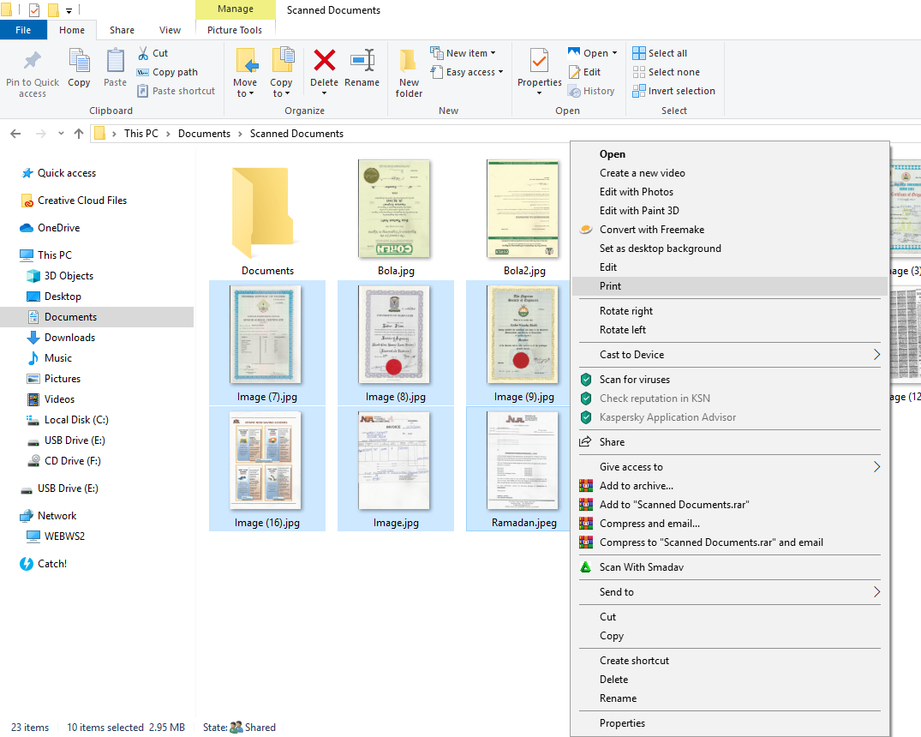
STEP 5
Select and Right click on the scanned Documents
Click PRINT from the listed menu.

Slide 8
STEP 6
Select Microsoft Print to PDF under Printer drop down menu.
Check Printer Properties under Options for correct Layout Orientation.
Click PRINT for conversion to PDF

Slide 9
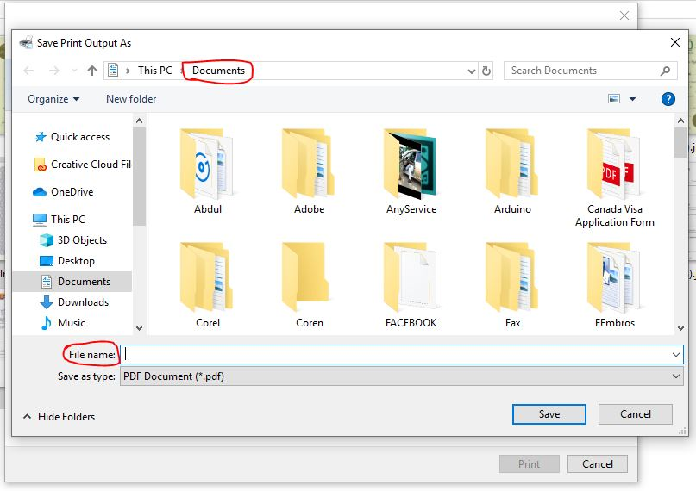
STEP 7
Select the Output Folder
Type the file name
Click SAVE

Slide 10
T H E E N D.
Thank you for listening

